Slide 1
Karamoja Food Security Monitoring Project
Analyzing Crop Yield and Population Density for Enhanced Food Security

Slide 2
Research Questions
How does crop yield vary between sorghum and maize in Karamoja?
What is the impact of population density on crop yield in different regions?
How do crop areas correlate with total productivity for sorghum and maize?
What are the spatial distributions of sorghum and maize fields across districts and sub-counties?

Slide 3
Objectives
To measure and compare the yields of sorghum and maize across different regions.
To determine the population density in relation to crop areas to understand pressure on resources.
To develop interactive dashboards to visualize crop yield, population density, and spatial distributions.
To provide actionable insights to NGOs to prioritize areas for support and intervention.

Slide 4
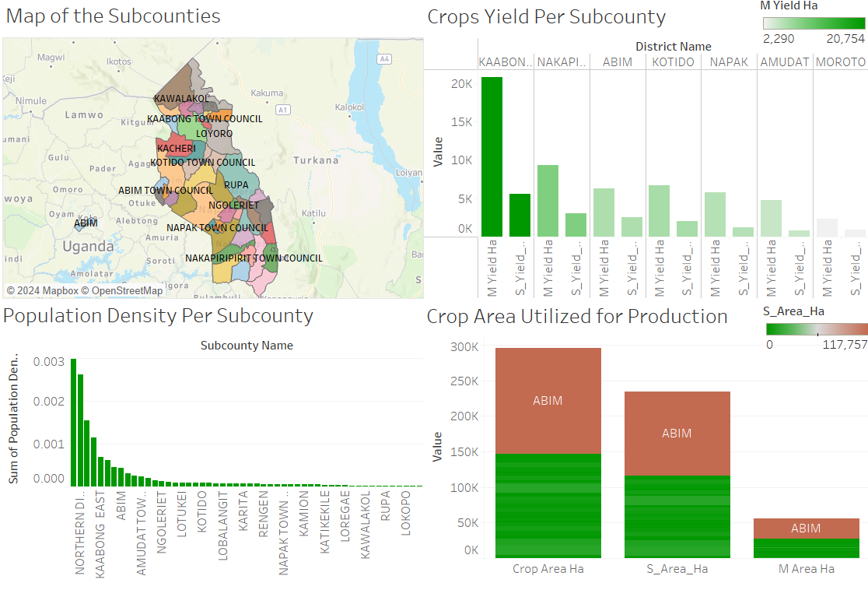
Visualization

Slide 5
Recommendations
Prioritize Support for Low-Yield Areas:
- Focus interventions on districts and sub-counties with the lowest crop yields to improve productivity.
Address Population Pressure:
- Develop strategies to manage population pressure in high-density areas to enhance food security.
Enhance Data Collection:
- Continue to collect and analyze crop and population data to monitor trends and adjust strategies as needed.

Slide 6
Conclusion
The analysis provides valuable insights into crop yields and population density, aiding NGOs in prioritizing their efforts in Karamoja. By leveraging the visualizations and recommendations, stakeholders can make informed decisions to improve food security in the region.

Slide 7
Thank you

